Slide 1
ET0023 Operating Systems
3. Programs & Processes
CPU Management

Slide 2
What is a Program?
A sequence of instructions that the computer follows to achieve some result.
Stored on secondary storage e.g. Hard disk or CD ROM
Text files that takes up hard disk space
Can consist of one or more files.
Notes:
Analogy for program and process: A cake baking class for four bakers.
The recipe is the program, the instructor is the processor and the process is the activity consisting of the four bakers reading the recipe, fetching the ingredients, and baking the cake.

Slide 3
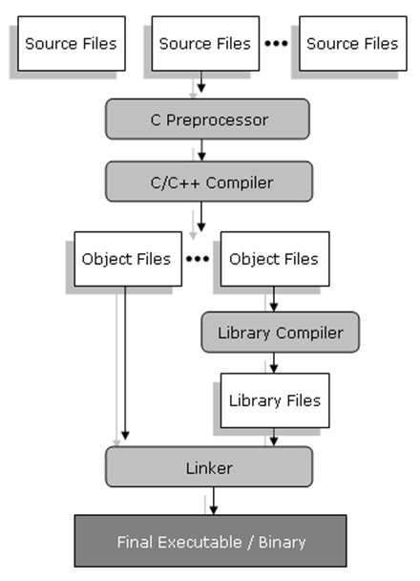
Program Creation
Created by software programmers
Usually in "English-like“ syntax
Converted to binary codes
Notes:
Compilers
Usually made up of a number of programs: compiler, optimizer, linker. Code is written in a text file and is fed into the compiler which converts it to intermediate code.
The Linker takes the intermediate code and combines it with system libraries to form executable code which can be directly loaded and executed
Interpreters
Usually made up of a single program which dynamically translates what is typed in (text) to intermediate code. The program may also be saved as a text file which is then read line-by-line and translated. When the command is given, the intermediate code is executed, there is no need for a linker, and there may libraries which are required.

Slide 4
What is a Process
An instance of a running program.
Consists of machine instructions, data area, stack and the machine registers it is using.
Processes are created when a user runs a program.
A process is a program in execution.
Notes:
The most central concept in any OS is the process: an abstraction of a running program.
Foreground processes interact with users and perform work for them.
Background process has some specific function, sleeping most of the time, waking up when request arrives.
Background services are also called daemons.
A process is a unit of executing software that is managed independently by the OS and can request and receive hardware resources and OS services.
Processes can communicate with other processes executing on the same computer or through the network.

Slide 5
Processes
The OS will load the program (using a loader) into memory.
The OS will then let the process run on the CPU
Processes will take up memory, CPU time and other hardware resources.
Each process will take up address space, registers and memory locations.
Notes:
There are four principal events that cause processes to be created:
1. System initialization
2. Execution of a process creation system call by a running process
3. A user request to create a new process
4. Initiation of a batch job

Slide 6
Processes
Stack
(heap) Data Area
Code / Constants
Associated with the process
Address space
Memory locations
Set of registers
Other information to run the program
Notes:
The stack and heap They are both stored in the computer’s RAM , they will grow towards each other as temp data is stored in a process.
In a highly recursive process, the process may crash if the stack and heap grow into each other.
Member m; //the object "m" is created in stack and it is destroyed once the function ends
Member* m = new Member( ) ; //the object "m" is created in heap and must be deleted otherwise a memory leak occurs
delete m;

Slide 7
Programs & Processes
Several users can run the same program at the same time (each run is a separate process)
A program can be made up of several processes.
On a single processor system, the processor can only execute one process at any given instant.
The OS can be maintaining several active processes but apply the processor to each one in turn. (time-sharing or multitasking)
Notes:
A process is just an instance of an executing program. Process execution progress must be in sequential fashion

Slide 8
Role of OS
Process Management
Creation of the process
Suspension and restart of the process
Establish mechanisms for process communications, process synchronization
Termination of the process
Notes:
Process Termination due to one of the following conditions:
1. Normal exit (voluntary)
2. Error exit (voluntary)
3. Fatal Error (involuntary)
4. Killed by another process (involuntary)

Slide 9
Process Execution
A process is a program executing in an address space.
During its execution, the process resides in memory, taking input, producing output.
Has access to
The CPU, so that instructions can be executed
The registers of the CPU
Memory areas where process instructions, data are stored
The CPU Stack
Services provided by the OS

Slide 10
Process Execution
When a process is executing, the OS will
Use hardware to ensure process is running in user mode
Use real or virtual resources
Ensure that process has access to memory areas
Limit access (read-only) to process instruction areas
The OS will be running in supervisory (monitor) mode.
Notes:
Real resource: A computer’s physical devices and associated system software.
Virtual resource: the apparent resources allocated by OS to the process, the OS make virtual resources appear to be equal or greater that real resources.

Slide 11
Process Table
All information about each process is stored in an OS structure called the process table.
The process table is stored in a data collection (e.g. array or linked list).
Each process currently in existence has an entry.
A suspended process consists of its address space (core image) and its process table entry.
Notes:
Process table is created by the kernel to keep track of the process.

Slide 12
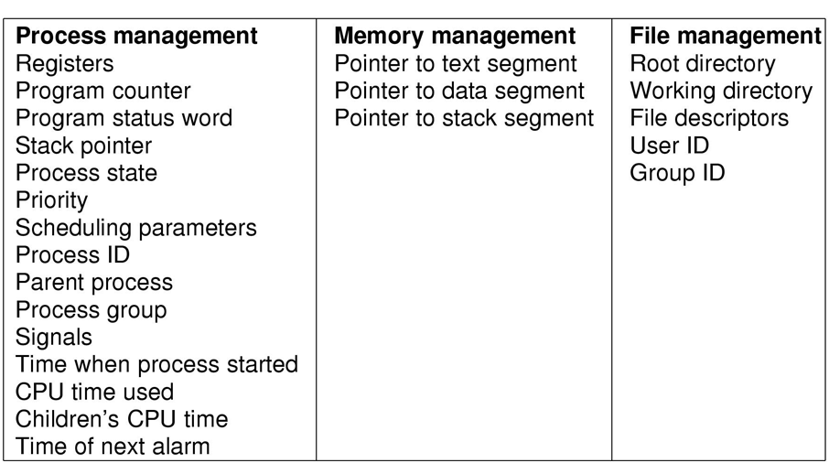
A Process Table Entry
Process Control Block (PCB)

Slide 13
Process Control Block
Contains information associated with the Process, usually includes
Process identifier
Process context
Program Counter, Processor Status Word, Registers content, Stack Pointer
Process state and priority
Resources allocated
Accounting information
Notes:
A process control block PCB is a data structure the OS maintains to keep track of each process.
The OS keep track of each process by creating and updating a data structure called process control block.
A PCB contains data items such as process state, process ownership and access privileges, resources allocated to and consumed by the process, and scheduling priority.

Slide 14
Parent-Child Processes
A process can create another process or processes
Parent => child processes
Child processes inherit the resources from the parent
Parent Process
Parent
suspends
Check-values (a, b, c)
temp = b^2 - 4*a*c
CalcRoot(a, b, c)
Child Process
myVar = a * a;
If (c > myVar)
….
Parent
resumes
Child process dies

Slide 15
Process Tree/Hierarchy
Parents/Child processes
A spawns 2 child processes, B and F
B executes first and spawns 3 child processes C,D,E
The child processes execute and complete, B completes
F then is executed
A
B
F
C
E
D

Slide 16
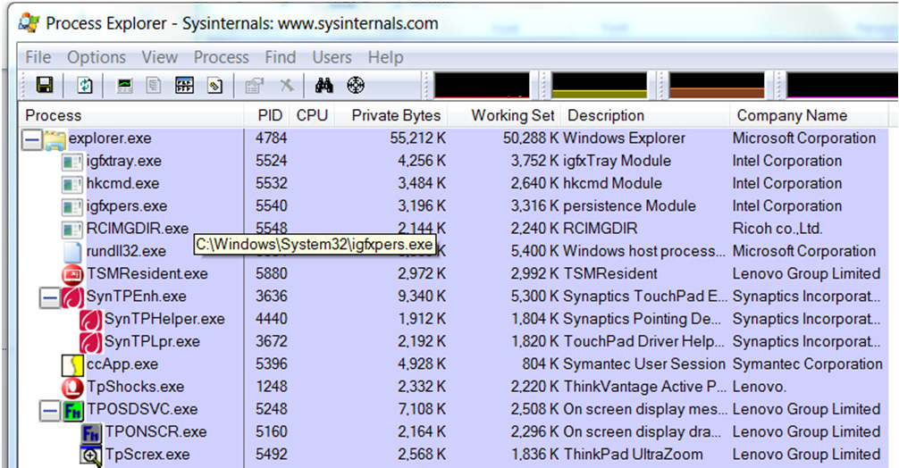
Parent-Child Processes

Slide 17
Parent-Child Processes
init-+-NetworkManager---{NetworkManager}
|-firefox-+-plugin-containe-+-npviewer.bin---7*[{npviewer.bin}]
| | `-{plugin-contain}
| `-24*[{firefox}]
|-gconfd-2
|-gdm-binary-+-gdm-simple-slav-+-Xorg
| | |-gdm-session-wor-+-gnome-session-+-applet.py
| | | | |-bluetooth-apple---2*[{bluetooth-appl}]
| | | | |-cairo-dock---{cairo-dock}
| | | | |-compiz-+-sh---unity-window-de---{unity-window-d}
| | | | | `-{compiz}
| | | | |-evolution-alarm---{evolution-alar}
| | | | |-gdu-notificatio
| | | | |-gnome-do---gnome-do---9*[{gnome-do}]
| | | | |-gnome-panel---{gnome-panel}
| | | | |-gnome-power-man---{gnome-power-ma}
| | | | |-nautilus---3*[{nautilus}]
| | | | |-nm-applet---{nm-applet}
| | | | |-polkit-gnome-au---2*[{polkit-gnome-a}]
| | | | |-python
| | | | |-python---{python}
| | | | |-ssh-agent
| | | | |-update-notifier---{update-notifie}
| | | | |-vino-server---{vino-server}
| | | | |-zeitgeist-datah---{zeitgeist-data}
| | | | `-2*[{gnome-session}]
| | | `-{gdm-session-wo}
| | `-{gdm-simple-sla}
| `-{gdm-binary}
% pstree

Slide 18
Parent-Child Processes
PPID PID PGID SID TTY TPGID STAT UID TIME COMMAND
1 962 962 962 ? -1 Ssl 0 0:10 gdm-binary
962 1114 962 962 ? -1 Sl 0 0:00 \_ /usr/lib/gdm/gdm-simple-slave --display
1114 1133 1133 1133 tty7 1133 Ss+ 0 489:41 \_ /usr/bin/X :0 -nr -verbose -auth /v
1114 1559 962 962 ? -1 Sl 0 0:00 \_ /usr/lib/gdm/gdm-session-worker
1559 1572 1572 1572 ? -1 Ssl 1000 0:08 \_ gnome-session --session=classic
1572 1648 1648 1648 ? -1 Ss 1000 0:03 \_ /usr/bin/ssh-agent /usr/bin
1572 1691 1572 1572 ? -1 Sl 1000 368:10 \_ /usr/bin/compiz
1691 1912 1912 1912 ? -1 Ss 1000 0:00 | \_ /bin/sh -c /usr/bin/com
1912 1913 1912 1912 ? -1 Sl 1000 20:01 | \_ /usr/bin/unity-wind
1572 1708 1572 1572 ? -1 Sl 1000 0:04 \_ nm-applet --sm-disable
1572 1709 1572 1572 ? -1 Sl 1000 1:03 \_ zeitgeist-datahub
1572 1719 1572 1572 ? -1 Sl 1000 0:00 \_ /usr/lib/evolution/2.32/evo
1572 1720 1572 1572 ? -1 Sl 1000 2:23 \_ gnome-panel
1572 1721 1572 1572 ? -1 SLl 1000 20:58 \_ /usr/lib/vino/vino-server -
1572 1750 1572 1572 ? -1 Sl 1000 0:18 \_ gnome-power-manager
1572 1902 1572 1572 ? -1 S 1000 0:05 \_ /usr/lib/gnome-disk-utility
1572 2051 1572 1572 ? -1 S 1000 0:23 \_ /usr/bin/python /usr/share/
1572 2201 1572 1572 ? -1 Sl 1000 0:22 \_ update-notifier
1572 11740 1572 1572 ? -1 Sl 1000 39:59 \_ nautilus
1 13080 1572 1572 ? -1 Sl 1000 0:02 gnome-terminal
13080 13084 1572 1572 ? -1 S 1000 0:00 \_ gnome-pty-helper
13080 13085 13085 13085 pts/0 13248 Ss 1000 0:00 \_ bash
13085 13248 13248 13085 pts/0 13248 R+ 1000 0:00 \_ ps axjf
% ps axjf

Slide 19
Single Tasking
Mono programming
Only one process is run at any time (No switching!!!)
E.g. MS-DOS, Embedded Software
Notes:
Single tasking OS is small and efficient, the OS do not need complex resource allocation procedures.
The OS reserves whatever resources it requires, all resources not allocated are available to the application program.
MS-DOS is the most common single-tasking OS.

Slide 20
Multitasking
CPU switches back-and-forth from process to process (very fast)
Appearance of running multiple programs at the same time (in fact, you're not!)
A single processor may be shared with several processes using a scheduling algorithm
A
B
C
D
Time
Notes:
In a multiprogramming system, the CPU switches from process to process quickly, running each process for a very short time slice.
At any instance of time, the CPU is running only one process. In the course of 1 second, it may work on hundred of them, giving the illusion of parallelism.
Although users only interact with one program at a time, multi-tasking OS enable other processes to run in the background.

Slide 21
Multitasking
Single program
counter
4 logical Program Counters
A
B
C
D
A
B
C
D
Notes:
In multi-programming, each process has its own flow of control, its own logical program counter. Each process run independently of each other.
When a process run, its logical program counter address is loaded into the physical program counter. When the current process finished, its logical program counter content is saved in memory. Thus over a long time interval, each process have made progress but at any given instant, only one process is actually running.

Slide 22
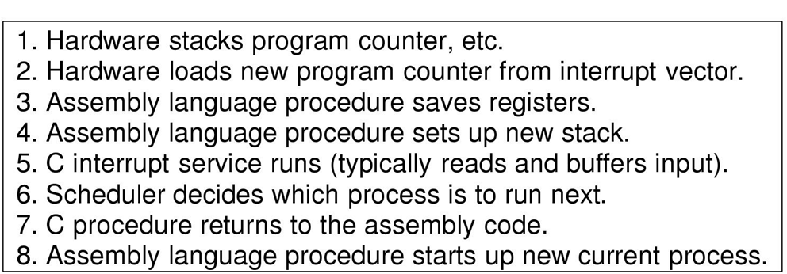
Process Switching
It takes time for the CPU to switch from one process to the other!
Notes:
Associated with each I/O class is a location called the interrupt vector. It contains the address of the interrupt service procedure.
When an I/O interrupt happens, the process’s program counter, status, and registers are pushed into the stack. The computer then jumps to the address specified in the interrupt vector. When the I/O interrupt finished, the scheduler is called to run the next process.
When process switches, all the entries about a process in the process control block and everything else about the process must be saved and pushed into the stack. The new process is then switched in and loaded into the CPU. However, Threads are part of a process, in thread switching, only the non-shared items such as thread ID, Program Counters, Registers, Stack need to be switched in. Most the shared items in the process table are retained in memory

Slide 23
Multitasking Systems
Cooperative Multitasking
Each process is given a timeslot (equal/unequal)
Process works through timeslot until request to release
Process may release or continue
Preemptive Multitasking
Each process is given a timeslot (equal/unequal)
Process works through timeslot
When time is up, process switches
If infinite loop detected, process switches
If important task is required, process switches
Notes:
Cooperative Multitasking: Multiple jobs are run on a single processor. Each job initially receives an equal time-slice. If job cannot complete, it can request for extension of time. Or if the job requires more time,
it can take more of the time slice
Preemptive Multitasking: Multiple jobs are run on a single processor. Each job initially receives an equal time-slice. The time-slice is managed by the Scheduler which will switch the process out regardless of whether
the process requires more time. This gives a more equal running time-slice per process

Slide 24
Process States
A process changes state in its life.
At any one time, a process may be in one of the following states:
New (the process is new)
Running (the process is running)
Waiting (the process is waiting for I/O to be completed)
Ready (the process is ready to be executed by CPU)
Terminated (the process has completed, exit)

Slide 25
Process States
new
terminated
admitted
2
dispatch
exit
ready
running
interrupt
4
3
I/O or Event wait
I/O or Event completion
1
waiting
Note direction of the arrows
which shows the transitions
Between states
Notes:
Process is blocks for input
Scheduler picks another process from those in ready states (not necessary the recent blocked process) and dispatched to running
I/O input is available and process exit the waiting state
Process is interrupted temporary and returned to ready state.

Slide 26
Process Scheduling
CPU switches from Process-to-process
Only one process can be truly active at a time.
CPU must share its time between executions of many processes
Scheduling – the process of sharing time
Purpose: to maximize CPU utilization in multiprogramming environment
Provides illusion that CPU is always with the user/task.
Notes:
Resource Allocation Goal
- meet each program’s resource needs
- prevent programs from interfacing with one another
- use hardware and other resources efficiently

Slide 27
Scheduling 2 processes
Process P1
Process P2
Save state to PCB1
Release state to PCB2
executing
idle
Save state to PCB2
Release state to PCB1
idle
executing
Save state to PCB1

Slide 28
Process Queues
Queue header
PCB1
PCB2
Job#1
Registers
Registers
Tape Unit
Backup
PCB3
PCB4
PCB5
Registers
Registers
Registers
Disk #1
PCB6
Output
Registers

Slide 29
OS Process Queues
Not very useful for multitasking but for scheduling devices.
Processes are placed on the ready queue.
Process is loaded onto ready queue
Process starts executing
I/o required, placed on I/O queue
Time slice expires, state is saved
Process keeps executing until complete Process Queues

Slide 30
Process Queues
start
exit
Ready
Queue
CPU
I/O
I/O queue
I/O request
Child Executes
Create Child
Time slice expired

Slide 31
Questions?

